Slide 1

Android Gestures
James Mamchur

Slide 2
Gestures with Computers
A Gesture
is the use of movements to communicate a prearranged signal
is a way to interact with a electronic device
is captured with a touch screen or mouse

Slide 3
Android Gestures
Supported since Android 1.6
Library Location is: android.gestures
Gestures allow for interactive Applications
Used through Android touch screens

Slide 4
Steps to Using Gestures
Create a Gesture Library
Save the Library
Load the Library
Configure Settings in the Layout File
Implement a Gesture Listener
Recognize Gestures in the Gesture Listener

Slide 5
Creating a Gestures Library (1/2)
Google has provided a tool called Gesture Builder to create a Gesture Library
The Gesture Builder has the following purposes
To create a gesture library
To add, edit or remove items from a gesture library
To Save the library
To view a gesture library

Slide 6
Creating a Gestures Library (2/2)
Requirements
Android API 1.6 or higher
A emulator or phone with an external SD card
Android SDK installed
Project location
Gesture Builder is found in the Android SDK examples

Slide 7
Running the Gesture Builder
Create a new Android Project
Note: only create if you have not done so already
Select a API Level higher then 1.6
Click the Radio Button that says:
“Create project from existing sample”
Select Gesture Builder
Click Finish
Run the Project

Slide 8
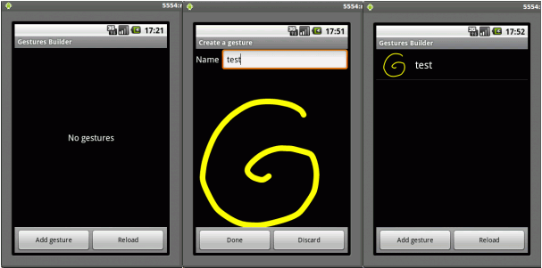
To Add A Gesture

Slide 9
Saving the Library
Gesture Builder saves to the emulators SD card
To get the file off of the SD card
Open the DDMS view in eclipse
In the Devices tab, select the emulator that you want to view the file system for.
To copy a file from the device, locate the file in the File Explorer and click the Pull file button.
Reference On the DDMS
http://developer.android.com/guide/developing/debugging/ddms.html

Slide 10
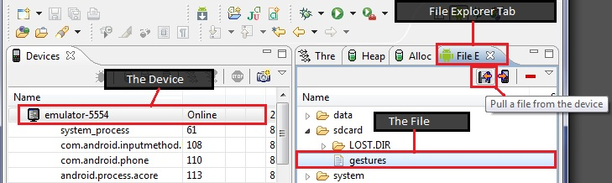
Saving The Library

Slide 11
Demo 1 –Creating a Gesture Library
Sit back and relax
I will demonstrate what I have talked about so far
Pro Tip: Follow along closely, you may need to do this later for the lab ;)

Slide 12
Loading the Library (1/2)
Create a project for using Gestures
In the “res” folder create a folder named “raw”
Put your saved Library In this folder
The next step involves
Adding code to open the library in onCreate()
Adding a listener to process gesture events

Slide 13
Loading the Library (2/2)
The following code opens the gesture library
mLibrary = GestureLibraries.fromRawResource(this, R.raw.gestures);
if (!mLibrary.load()) {
finish();
}
Note you also need to make a class variable
private GestureLibrary mLibrary;

Slide 14
The Layout File (1/2)
Add a gesture view to your activity
<android.gesture.GestureOverlayView
android:id="@+id/gestures"
android:layout_width="fill_parent"
android:layout_height="0dip"
android:layout_weight="1.0" />
A gesture view can be contained in a view or it can be used on top of other views
This is to enable you to be able to detect a motion anywhere on the screen
This example was used inside of a linear layout

Slide 15
The Layout File (2/2)
Here is another example layout file
<android.gesture.GestureOverlayView
xmlns:android="http://schemas.android.com/apk/res/android"
android:id="@+id/gestures"
android:layout_width="fill_parent"
android:layout_height="fill_parent"
android:gestureStrokeType="multiple"
android:eventsInterceptionEnabled="true"
android:orientation="vertical">
<ListView
android:id="@android:id/list"
android:layout_width="fill_parent"
android:layout_height="fill_parent" />
</android.gesture.GestureOverlayView>

Slide 16
Implementing a Gesture Listener
After you have opened your library you need to add a listener
GestureOverlayView gestures = (GestureOverlayView) findViewById(R.id.gestures);
gestures.addOnGesturePerformedListener(this);
The activity that has gestures must have
implements OnGesturePerformedListener
Make your activity implement all abstract methods
This will create a method called onGesturePerformed()

Slide 17
Recognizing Gestures (1/4)
When a gesture is performed it needs to be detected and processed
Events are processed in the following method
onGesturePerformed()
A call is made to the gesture library that was loaded in
The library will to try to recognize the gesture and return a list of predictions with scores

Slide 18
Recognizing Gestures (2/4)
Here is some sample code
public void onGesturePerformed(GestureOverlayView overlay, Gesture gesture) {
ArrayList<prediction> predictions = mLibrary.recognize(gesture);
// We want at least one prediction
if (predictions.size() > 0) {
Prediction prediction = predictions.get(0);
// We want at least some confidence in the result
if (prediction.score > 1.0) {
// Show the gesture name
Toast.makeText(this, prediction.name, Toast.LENGTH_SHORT).show();
}
}
}

Slide 19
Recognizing Gestures (3/4)
The previous example just displayed the predicted event if a gesture event was detected
This is not good enough if you want to trigger a action based on a specific gesture event
The following example on the next page shows how to process gesture events

Slide 20
Recognizing Gestures (4/4)
This is sample code for processing specific gesture events
public void onGesturePerformed(GestureOverlayView overlay, Gesture gesture) {
ArrayList<Prediction> predictions = mLibrary.recognize(gesture);
if (predictions.size() > 0 && predictions.get(0).score > 1.0) {
String action = predictions.get(0).name;
if ("action_add".equals(action)) {
Toast.makeText(this, "Adding a contact", Toast.LENGTH_SHORT).show();
} else if ("action_delete".equals(action)) {
Toast.makeText(this, "Removing a contact", Toast.LENGTH_SHORT).show();
} else if ("action_refresh".equals(action)) {
Toast.makeText(this, "Reloading contacts", Toast.LENGTH_SHORT).show();
}
}
}

Slide 21
Demo 2 – A Simple Gesture App
Once again sit back and relax
I will demo a simple gesture application

Slide 22
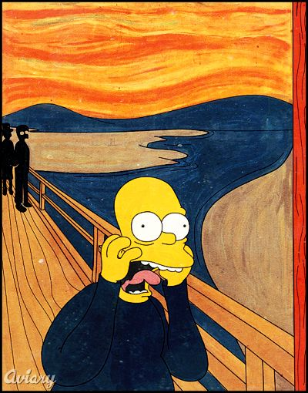
The Lab
Make a gesture library
Save it
Create a project
Add the library to your project
Make a simple project like demonstration 2
Everything you need is in the slides!!!
Feel free to ask me questions

Slide 23
The Answer!
I will now demonstrate the answer
Please follow along if you want to have a copy
Tell me if I am going to fast
I will ask for feedback to see how everyone is doing

Slide 24
The End
Questions?

